Slide 1




Slide 2
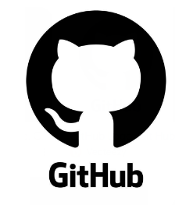



Slide 3
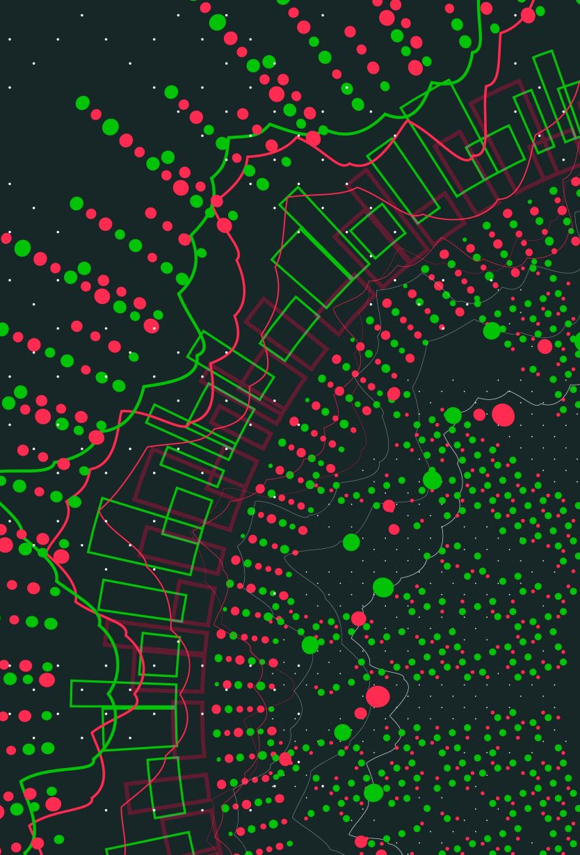
Git
Git is not the same as GitHub or GitLab
Git is a distributed version control system, extensively used in software development.
When you're working on a project with multiple people, Git tracks all the changes made to the code
This allows multiple developers to work on the same project at the same time without interfering with each other's work.

Slide 4


NodeJS
Open-source software (OSS) is computer software that is released under a license in which the copyright holder grants users the rights to use, study, change, and distribute the software and its source code to anyone and for any purpose.
A cross-platform runtime environment (RTE) is a software platform that allows applications to run on multiple operating systems (OS).
NodeJS allows you to execute JavaScript code outside of a web browser
NodeJS built on Chrome's V8 JavaScript engine
NodeJS enables developers to use JavaScript for server-side scripting

Slide 5
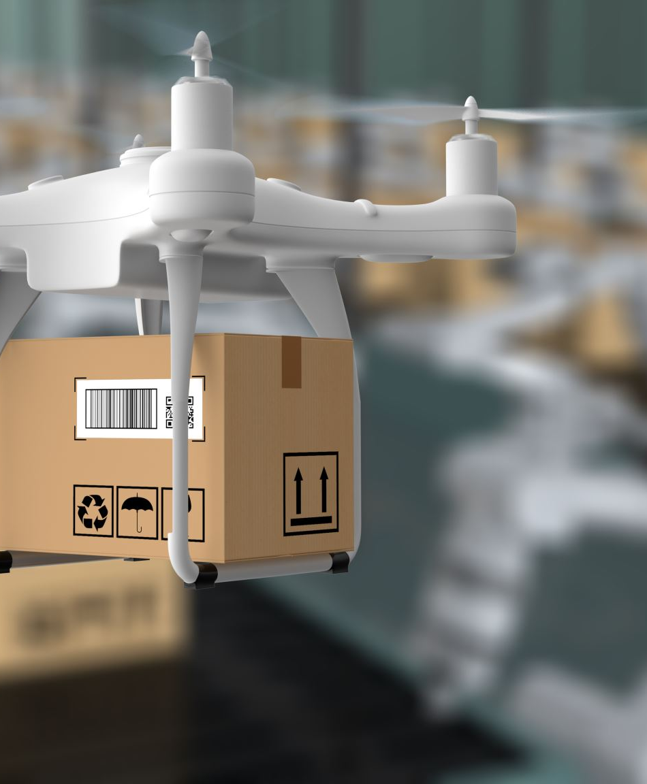
NPM (Node Package Manager)
Standard package manager for Node.js
The official web site is npmjs.com
The official site where you can browse packages, read documentation, and find general information about NPM
The site also offers resources for both free and Pro users
Various tools for JavaScript development

Slide 6

GitHub Desktop
GitHub Desktop is a free, open-source application
GitHub Desktop enables you to interact with GitHub repositories using a graphical user interface (GUI)
You can use GitHub Desktop rather than the command line or a web browser
You can decide which files to commit to your GitHub repository
Each commit will include the author's name and a commit message
If there are files you don't want to commit, you can add file path and file name to the .gitignore file.

Slide 7

Visual Studio Code
Visual Studio Code, commonly known as VS Code
Visual Studio Code developed by Microsoft
key features
integrated debugging tools
syntax highlighting
intelligent code completion
reusable snippets of code
code refactoring tools
built-in support for version control with Git

Slide 8

Docker Desktop
Docker Desktop simplifies the process of building, sharing, and running containerized applications
Comprehensive command line interface (CLI ) tools to manage Docker containers and images seamlessly
Docker Desktop, developers can create, test, and debug containers on their local machines
Supports both Windows and macOS operating systems
Key features include Kubernetes integration
Developers can run Kubernetes clusters locally

Slide 9

Docker
Here’s a quick breakdown of Docker’s key features:
Isolation: Each container runs in its own isolated environment, like a virtual machine but without the overhead of running a full operating system.
Portability: Containers can run on any system that supports Docker, making it easy to move applications between different environments.
Efficiency: Containers share the host system’s kernel, which makes them more lightweight and faster to start compared to virtual machines.
Consistency: By packaging everything your application needs, Docker ensures that it runs the same way in development, testing, and production environments, reducing the “it works on my machine” problem.

Slide 10

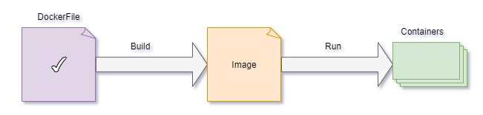
Docker File
Here are some key points about Dockerfiles:
Base Image: The FROM instruction specifies the base image to use for the Docker image.
Commands: Instructions like RUN, CMD, and ENTRYPOINT define commands to be executed inside the container.
File Operations: COPY and ADD are used to copy files and directories into the image.
Environment Variables: ENV sets environment variables.
Ports: EXPOSE specifies which ports the container will listen on.
Metadata: LABEL adds metadata to the image.

Slide 11
Example of a Dockerfile
# Use an official Python runtime as a parent image
FROM python:3.8-slim
# Set the working directory in the container
WORKDIR /app
# Copy the current directory contents into the container at /app
COPY . /app
# Install any needed packages specified in requirements.txt
RUN pip install --no-cache-dir -r requirements.txt
# Make port 80 available to the world outside this container
EXPOSE 80
# Define environment variable
ENV NAME World
# Run app.py when the container launches
CMD ["python", "app.py"]

Slide 12

Docker Image
Docker images are built using the Dockerfile
Docker image is a file used to execute code in a Docker container
Docker images act as a set of instructions to build a Docker container
Docker images also act as the starting point
Docker image is comparable to a snapshot in virtual machine (VM) environments
Docker images have multiple layers
Docker image can be pushed to the docker hub and pulled by others with different OS environments

Slide 13

Docker Container
Docker container image is a lightweight, standalone, executable package
Docker container as another form of virtualization
Docker Daemon takes the commands a developer enters the Docker client terminal and executes them
This approach allows pieces of code to be put into smaller, easily transportable pieces that can run anywhere

Slide 14

Docker Compose
Docker Compose is a tool that simplifies the process of defining and running multi-container Docker applications.
Configuration with YAML: You define your application’s services, networks, and volumes in a single YAML file
Single Command Operations: You can stop, rebuild, and manage the lifecycle of your application with simple commands.
Multi-Environment Support: Docker Compose works in various environments, including development, testing, staging, and production.
Service Management: You can view the status of running services, stream log outputs, and run one-off commands on services

Slide 15
docker build -t node-docker-app .
docker build: This is the Docker command to build an image from a Dockerfile.
-t node-docker-app: The -t flag allows you to tag the image with a name. In this case, the image is tagged as node-docker-app.
. :The period at the end specifies the build context, which is the current directory. Docker will look for a Dockerfile in this directory to build the image.

Slide 16

docker run -p 3000:3000 node-docker-app
docker run: This command is used to create and start a new container from a specified image.
-p 3000:3000: This flag maps port 3000 on your host machine to port 3000 in the container. This means that any traffic to port 3000 on your host will be forwarded to port 3000 in the container.
node-docker-app: This is the name of the Docker image from which the container will be created.

